Slide 1
CS 540 Network Architecture
Lecture 10 : TCP for High Speed Transport, TCP friendly protocol
Prof. Younghee Lee

Slide 2
TCP for high speed transport
A scientist needs to transfer a 1.5 TB file through Long Fat Network(LFN)
10 Gbps link available, 100 ms RTT, 1500-byte packets(MSS)
How long does it take to transfer the file without loss?
TCP: ~77 minutes ➔ more than 3 times longer than expected
at full link speed: 20 minutes
Why?
Window: W=83,333 in-flight segment required (10G*RTT/(MSS*8))
83,333 * 1500 * 8 ➔ average 10⁹ bit transmission without bit error
Loss rate with assumption of no timeouts and perfect loss recovery: 4*10⁻¹⁰ => too small!
BER of optical fiber => 10⁻¹⁰ or worse
Probability of a packet error: 1500 * 8 * 10⁻¹⁰ ➔ 1.2 x 10⁻⁶ ➔ much higher
What will happen with satellite link?
Time to next loss: (W/2) * RTT => 4,167 seconds => more than 1 hour!!!
What if any packet loss occurs within 4,167 seconds => ½ cwd => …..
BW = ¾ * W * MSS / RTT
p = 8/3W²

Slide 3
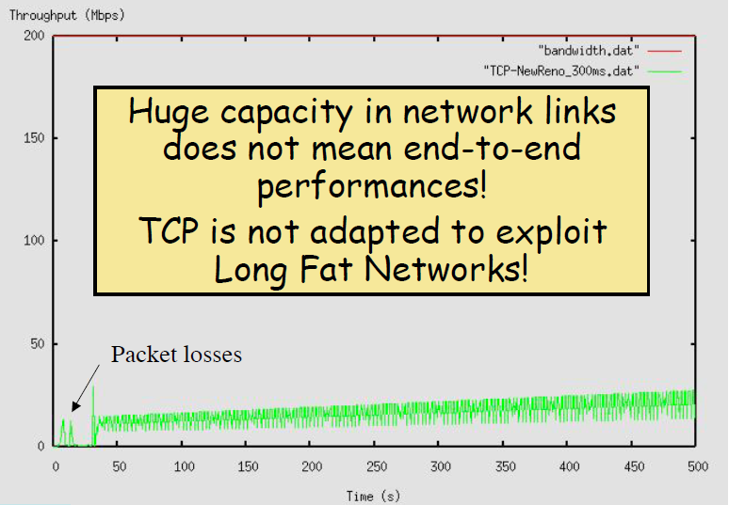
TCP for high speed transport
Never reached to link speed

Slide 4
TCP for high speed transport
Default maximum window size: 64kbyte
Much smaller than 83,333 segment
Need window scale option during connection setup phase
The receive window size may be increased up to a maximum value of 1,073,725,440 bytes => 716k segment
How to solve the problem?
Multiple TCP connection?
Ok! Simplest way. but not enough
W
¾ W
W/2
W/2
Time

Slide 5
TCP Alternatives: HS-TCP
High Speed TCP (HS-TCP): [Floyd, RFC 3649, 2003]
w <= thresh: same as Standard TCP like RENO
thresh : default 38
w > thresh: more aggressive increase, less aggressive decrease
table-driven increase/decrease factors
Uses a table to indicate by how much to increase cwnd when an ACK is received
The larger the cwnd, the larger the increment, and the smaller the decrement.
each RTT: w += [1, 72]
on loss: w = [0.5, 0.9] w

Slide 6
TCP Alternatives: S-TCP
Introduced by Tom Kelly of Cambridge 2003
Scalable TCP (S-TCP)
modification to HS-TCP to avoid need for table
each RTT: w += 0.01 w
on loss: w = 0.875 w
Uses exponential increase everywhere (in slow start and congestion avoidance)
Extremely slow converge – due to MIMD
Worst TCP friendliness among other protocols

Slide 7
TCP Alternatives: Fast-TCP
Developed at Caltech by Steven Low and collaborators
Based on TCP Vegas
Uses both queuing delay and packet losses as congestion measures
Why delay-based?
queuing delay can be more accurately estimated than loss possibility
The dynamics of queuing delay have the right scaling with respect to network capacity
Provides finer measure of congestion
Components of Fast-TCP architecture
Estimation – of average queuing delay and RTT after each Ack/triple dup-ack arrives
Fast TCP outperforms STCP in terms of fairness and efficiency
Good convergence time

Slide 8
TCP Alternatives: BIC-TCP
w <= thresh: same as Standard TCP:
w > thresh: binary search increase, less aggressive decrease
on loss: w = 0.875 w, β = 0.875
Additive Increase:
If |midpoint - Wmin|>=Smax, cwnd += Smax : increase by Smax
When the distance to the midpoint from the current minimum is too large, increasing the window size Smax per RTT until the distance becomes less than Smax
Wmax: window size just before the last fast recovery(packet loss occurred)
Wmin: window size just after the fast recovery: Wmin = β * Wmax
midpoint = (Wmax + Wmin) / 2; become Wmax if packet loss, become Wmin if not
Smax: maximum increment

Slide 9
TCP Alternatives: BIC-TCP
Binary search increase: continue this process until
|midpoint - Wmin| <= S_{max} logarithmic increase!
The algorithm repeatedly computes the midpoint between Wmax and Wmin, sets the current window size to the midpoint: cwnd = midpoint
and checks for feedback, in the form of packet losses.
The midpoint is taken as the new W_{max} if there is a packet loss, and as the new W_{min} if not.
The process repeats, until the difference between midpoint and Wmin falls below a preset threshold, called the minimum increment (S_{min}):
If |midpoint - Wmin| <= Smin, cwnd = Wmax

Slide 10
Binary Search with Smax and Smin
Available Bandwidth
Wmax
Smin
Binary search increase: computes the midpoint between Wmax and Wmin, sets the current window size to the midpoint
- The midpoint is taken as the new Wmax if there is a packet loss
- w = 0.875 w
Additive increase: |Wcurrent-Wmin|>=Smax, increase by Smax
Smax
Wmin

Slide 11
TCP Alternatives: BIC-TCP
Slow Start: after the window grows past the current maximum
Increase like slow start until cwnd < Wmax + Smax
Wmax+Smin, Wmax+2*Smin, Wmax+4*Smin, ..., Wmax+Smax
If cwnd > Wmax + Smax, cwnd = cwnd + Smax ; additive increase
Fast convergence:
Suppose there are two flows with different window sizes, but with the same RTT. Since the larger window reduces more in multiplicative decrease (with a fixed factor β), the time to reach the target is longer for a larger window.
Since window size increases logarithmically, both larger and smaller windows can return to their respective maxima very fast almost at the same time

Slide 12
Binary Increase Congestion Control (BIC)
Slow Start: after the window grows past the current maximum
W_{max}+S_{min}, W_{max}+2*S_{min}, W_{max}+4*S_{min}, ..., W_{max}+S_{max}
Binary search increase
Additive increase

Slide 13
Drawbacks of BIC-TCP
cwnd growth is too aggressive for TCP with short RTT
cwnd control is too complex

Slide 14
TCP Alternatives: CUBIC
Enhanced version of BIC
Less aggressive, Simplify and enhance the window control of BIC
each RTT: w increased based on cubic function
Wcubic=C(t-K)³+Wmax
C : scaling factor, Wmax: the window size just before the last window reduction, t: the elapsed time from the last window reduction
K is updated at the time of last lost event
on loss: w = 0.8 w
Window growth around Wmax is slow, and Window growth away from Wmax is fast
Increases stability and scalability
As window growth is independent of RTT, defined in real time
much more TCP-friendly
Drawbacks of CUBIC
Slow Convergence

Slide 15
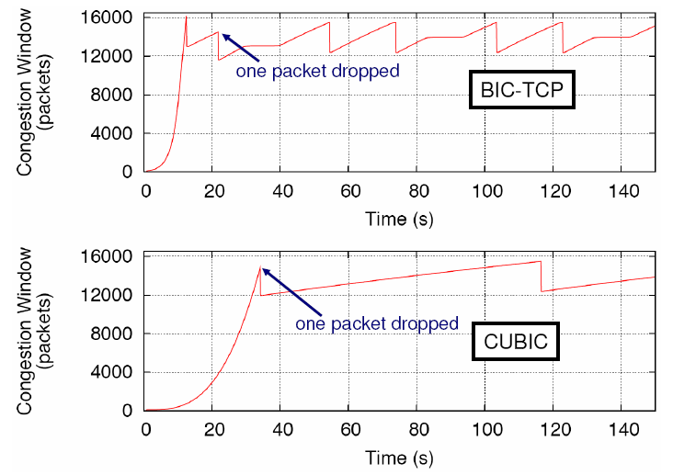
TCP Alternatives: CUBIC

Slide 16
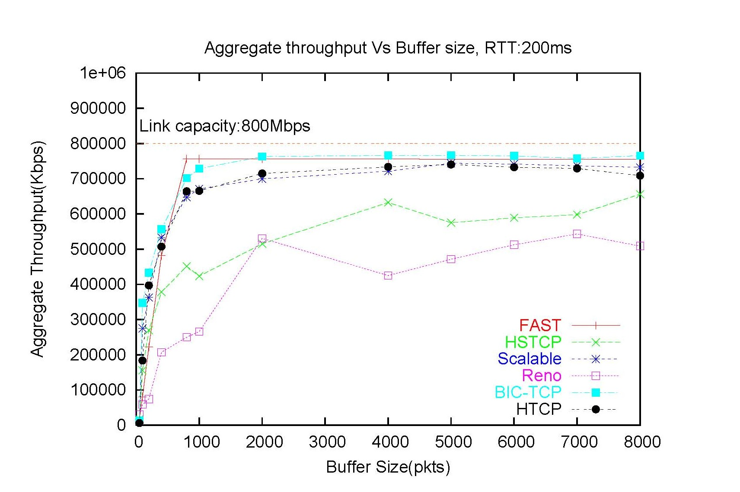
Buffer Size and Throughput

Slide 17
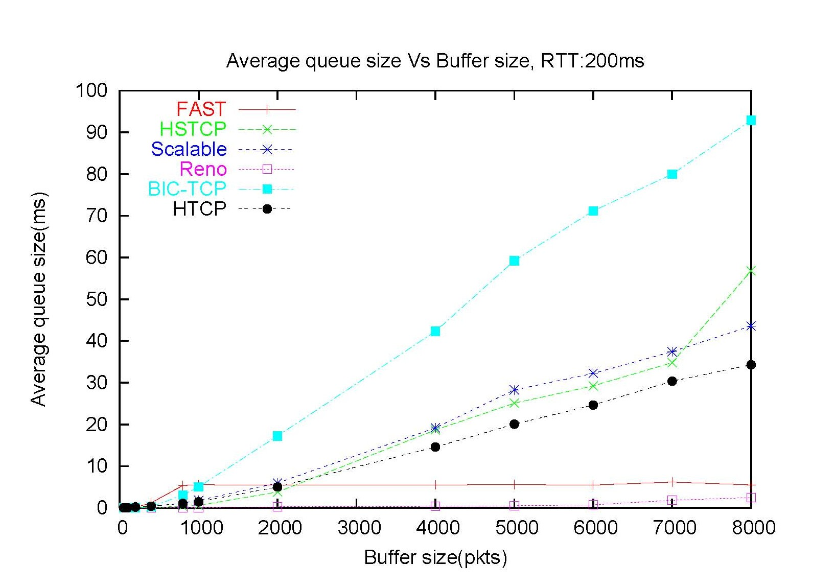
Queue Size Vs. Buffer Size

Slide 18
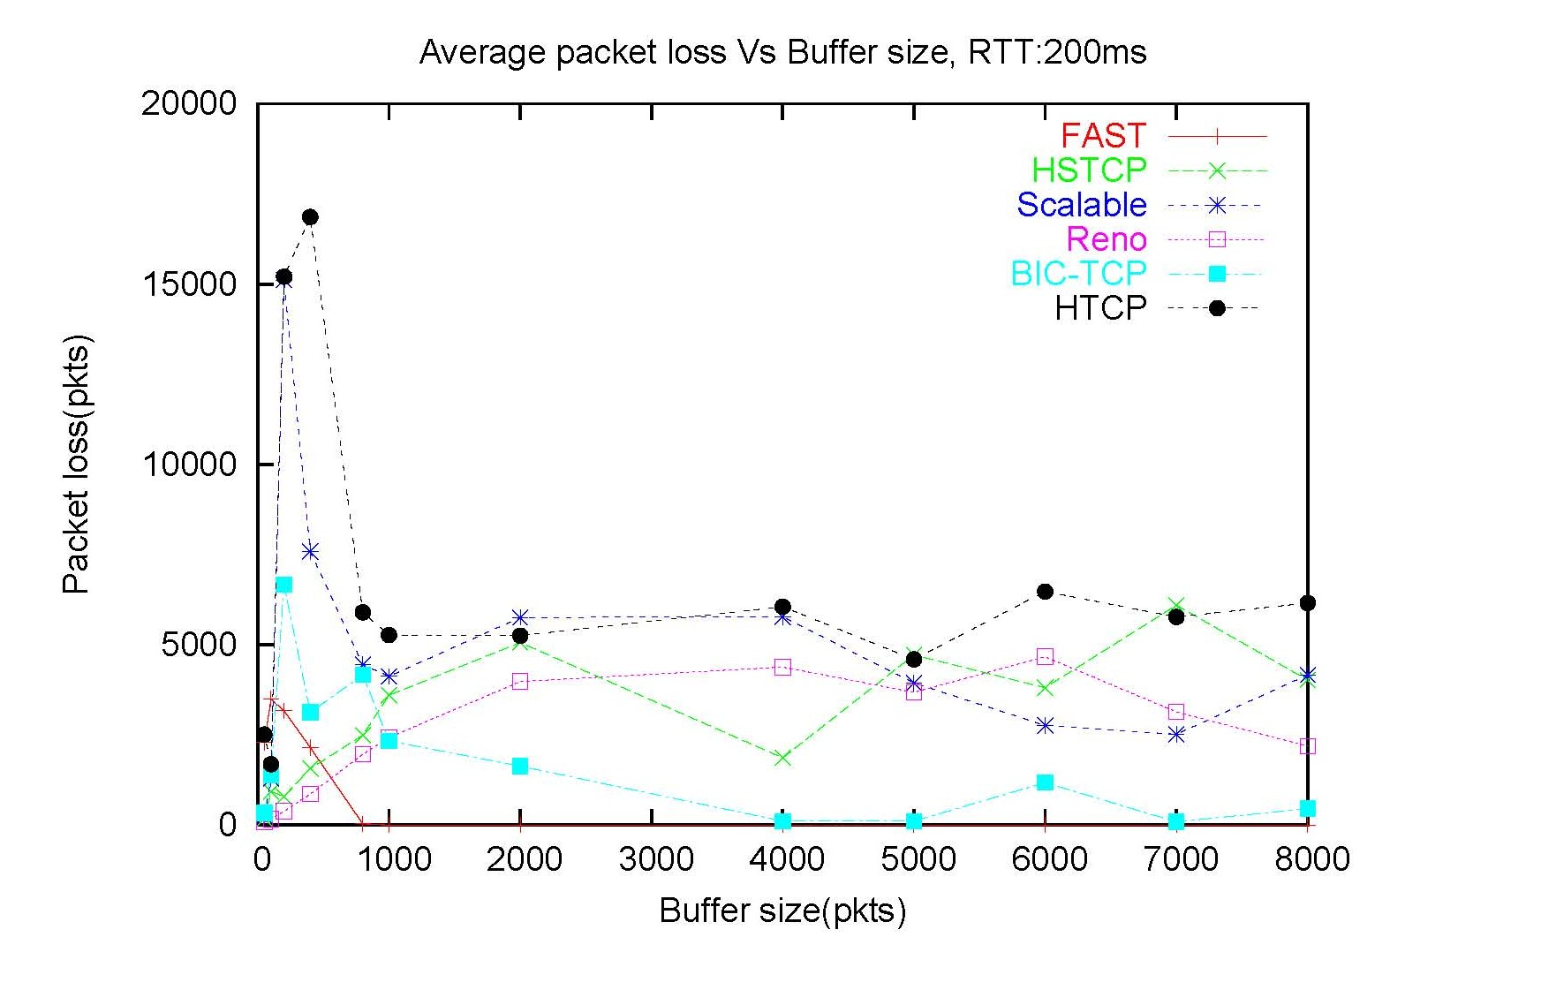
Packet loss vs. Buffer Size

Slide 19
TCP Alternatives
Overhead
All protocols – greater overhead than standard TCP
slightly greater overhead for small queue size, drastically lesser overhead for larger queue size
except for Fast-TCP
Convergence time
S-TCP, BI-TCP – extremely slow convergence time
Fast-TCP – best convergence time
H-TCP similar to standard TCP for low bandwidth

Slide 20
TCP
http://androidmodguide.blogspot.kr/p/tcp-algorithms.html
https://www.google.co.kr/webhp?sourceid=chrome-instant&ion=1&espv=2&ie=UTF-8#q=high+speed+tcp&newwindow=1&tbs=qdr:y

Slide 21
TCP Friendliness
TCP friendly
Any new congestion control must compete with TCP flows
How is this quantified/shown?
Has evolved into evaluating loss/throughput behavior
If it shows 1/sqrt(p) behavior it is ok : sqrt(p): square root p
But is this really true?
Simple loss model:
Assumption: no timeouts and perfect loss recovery

Slide 22
TCP Friendly Rate Control (TFRC)
Key parameters: RTO, RTT, Loss rate
Uses a control equation that explicitly gives the maximum acceptable sending rate as a function of the recent loss event rate
Sender adapts its sending rate, guided by this control equation, in response to feedback from receiver

Slide 23
TCP Friendly Rate Control (TFRC)
The benefit of TFRC, relative to TCP, is a more smoothly-changing sending rate
No report(Sn & recv time) from the receiver? => Stop sending
Control equation
Sending rate

Slide 24
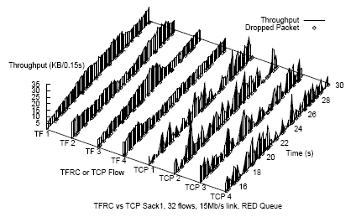
TCP Friendly Rate Control (TFRC)
TFRC:
Sender explicitly adjusts its sending rate as a function of the measured rate of loss events

Slide 25
TCP Friendly Rate Control (TFRC)
RTT estimation
EWMA: RTT_{n+1} = (1-)RTT_{n} + RTTSAMP
exponentially weighted moving average
EWMA for TCP RTT estimation
 = ? (TCP case :  = 0.125)
Small (.1) → long oscillations due to overshooting link rate
Large (.5) → short oscillations due to delay in feedback (1 RTT) and strong dependence on RTT
Solution: use large  in T rate calculation but use ratio of RTTSAMP^{.5}/RTT^{.5} for inter-packet spacing

Slide 26
TCP Friendly Rate Control (TFRC)
Loss estimation
Loss event rate vs. loss rate
Loss event: consists of one or more packets dropped within a single RTT
Characteristics
Should weight recent samples more
Should increase only with a new loss
Should decrease only with long period without loss
Possible choices
Dynamic window – loss rate over last X packets
EWMA of interval between losses
Weighted average of last n intervals: Last n/2 have equal weight
One loss event

Slide 27
TCP Friendly Rate Control (TFRC)
Loss estimation
Dynamic windows has many flaws:
Loss events entering and leaving the window cause changes to the measured loss rate -> unnecessary noise to the loss signal
Difficult to choose weight for EWMA
Weight that responds promptly to loss events in several successive RTTs and also doesn’t over-emphasize the recent loss interval
Solution WMA
Choose simple linear decrease in weight for last n/2 samples in weighted average
Include it when it actually increases WMA value

Slide 28
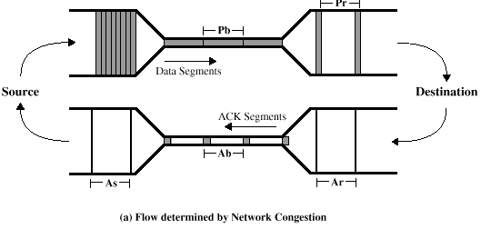
Slow Start
Used in TCP to get rough estimate of network and establish ack clock
TCP ensures that overshoot is not > 2x (exponential growth 2x)
Rate based protocols have no such limitation – why?
No ack – clock mechanism
TFRC slow start
New rate set to min(2 * sent, 2 * recvd)
Feedback the rate that packets arrived at the receiver during the last measured RTT
Ends with first loss report → rate set to ½ current rate

Slide 29
Congestion Avoidance
Loss interval increases in order to increase rate
Primarily due to the transmission of new packets in current interval
History discounting increases interval by removing old intervals:
History discounting begins after an extended absence of congestion
Limit of increase of sending rate .14 packets per RTT without history discounting
.22 packets per RTT with history discounting
Much slower increase than TCP
Decrease is also slower
4 – 8 RTTs to halve speed

Slide 30
DCCP (Datagram Congestion Control Protocol)
UDP with congestion control
Maybe more like TCP without reliability
“Pluggable” congestion control algorithms
congestion control IDs (CCIDs)
CCID2, AIMD, TCP-like
CCID3, TCP-Friendly Rate Control (TFRC)
RFC 4340 (main protocol), RFC 4341 (CCID2) RFC 4342 (CCID3)
Other CCID work in draft:
TFRC-SP – TFRC for small packets, draft-floyd-ccid4
TFRC Faster Restart, draft-ietf-dccp-faster-restart
RFC3448bis, TFRC update, draft-ietf-dccp-rfc3448bis

Slide 31
DCCP and Media Applications
Divides streaming media into three classes:
One-way, prerecorded
One-way, live
Two-way, interactive
One-way apps relatively easily adapted to TFRC
Two-way apps have problems
Media apps operate at a frame rate that has nothing to do with RTT: no retransmission
Can only make rate adaptations at frame boundaries
Media apps sometimes make abrupt rate changes at frame boundaries
Voice goes from zero to max => Faster restart to solve?
Video never zero, but can vary 10 to 1 from frame to frame
Small packets
Voice uses small packets, is perhaps unfairly penalized by packet-rate algorithms: TFRC-SP (draft-floyd-dccp-ccid4) address this issue

Slide 32
DCCP WG
Last e-mail I received (Nov. 26, 2012):
As of Nov. 29, 2012
Hello, as you may have noticed, the RFC on UDP encapsulation of DCCP is now published, and there is nothing left to be done on the DCCP WG milestones list. I am going to ask for the Working Group to be closed. The necessary specifications have all been completed and are stable, and not much other activity on extensions, new CCIDs, etc seems to be going on, which would justify keeping the group chartered. Thanks to everyone who participated over the years to reach this state! After discussion with Pasi, we think it may be a good idea to leave the mailing list open for a year or so, in case there are any questions from people implementing and using DCCP. After then, we'll reassess whether leaving the mailing list available is having any value. Any new proposals for DCCP maintenance or extension should go to TSVWG (tsvwg@ietf.org).

Slide 33
Reading Assignment
CLAUDIO CASETTI et al., “TCP Westwood: End-to-End Congestion Control for Wired/Wireless Networks”
GAVIN HOLLAND et al., “Analysis of TCP Performance over Mobile Ad Hoc Networks”
Submit less than 1 page report online via KLMS by 6pm Oct. 12 which is the day before the lecture of Oct. 13 (Thur.)
Submit also hard copy report at the beginning of the lecture of Oct. 13 (Thur.) as attendance check and for discussion

Slide 34
Discussion: picked up randomly
This paper claimed that a critical problem happens when each flow has different RTTs. The congestion control algorithms adjust window sizes using loss rate of ACKs. However, the rate of controlling window size is totally different because all flows have their own RTTs. Therefore, the algorithms cannot control correctly. This paper suggests BIC, a kind of binary search algorithm, in order to control window size. I wonder how often the algorithm changes window size. BIC is less flexible than classical TCP control algorithms. It may be vulnerable when heavy congestions occurs. Feedbacks from ACKs are useful in various network layers. I wonder some other ways to use ACKs instead of controlling window size.
It seems that BIC also includes additive increase, slow start and fast convergence, the impact of binary search increase itself seems to be rather little (based on Fig. 5), the combination of these technique is their contribution. This leads to BIC to compatible with other algorithms (e.g., HSTCP, STCP), not over-performing over them. - Especially, in Fig. 8., SHCTP and HSTCP is more "scalable" (high sending rate when low probability of loss event) than proposed algorithm, then is the BIC sacrificing scalability to achieve higher RTT fairness and TCP friendliness?

Slide 35
Discussion: picked up randomly
This protocol is made of two parts: binary search increase and additive increase. I wonder if the binary search increase algorithm is not too costly. How about performance? Regarding the growth function, isn’t it too aggressive for TCP in certain conditions (low speed networks)? The paper assumes the Internet networks are all fast but that is not always the case. The presented results from the experiments look very good. Another good sign is that BIC was included in the standard Linux distribution from kernel 2.6.8 to 2.6.19. It has now be replaced by CUBIC, which is an improvement of BIC.
Although BIC achieves pretty good scalability, fairness, and stability with high speed environments, I think the BIC’s growth function can still be too aggressive for TCP, especially under short RTT or low speed networks. How to solve such problems? Complexity issue: since the protocol has several different phases of window control, analyzing it will add a lot of complexity? On an early packet drop, BIC may suffer in its initial ascent due to an incorrect estimate of the maximum link capacity?

Slide 36
Discussion: picked up randomly
I wonder this algorithm can widely use in various congestion situations. TFRC uses weight function to control the “recent” events. I think the matric (how recent they are) is also critical to control link rates. In my point of view, it is only helpful for my links to use TFRC. I mean, what if the others use other TCP algorithms such as AIMD? I think the link using AIMD starves forever.
I wonder that TFRC's initial motivation might be less variable in terms of throughput so that achieving higher average throughput across the connections, but the simulation results seems that it shows less variance, but similar level of average throughput. Since they did not clearly write the advantage of "only" less variance in it, what is main reason to use this rather than vanilla AIMD? - Moreover, in heavily overloaded network conditions, although the mean TFRC throughput is similar to that of TCP, TFRC flows show a greater variance between their throughput than TCP flows do. Considering the background of previous paper, in high-speed network their may be more congested links so that this situation might be frequently happen, then how can TFRC be improved?

Slide 37
Discussion: picked up randomly
It seems to me that the receiver has to send back a lot of data to the emitter, as feedback. Could this be problematic? I think it would require quite a lot of computing power also. Moreover, it somehow obliges to keep internal state. TRFC appears to be a viable alternative to TCP in most cases. However, on short timescales, TCP outperforms TRFC. In my opinion though, measuring the rate of loss events is pretty complex. The papers also acknowledges that reacting to loss events in some cases is slower with TRFC than with TCP variants. Moreover, it does not allow variable length pack sizes. Finally
However, this can be a problem in situations of real congestion. With regard to this, the papers states that “TFRC flows show a greater variance between their throughput than TCP flows do” when the network is heavily overloaded, i.e. congested. Finally, I wonder how a network made of TRFC hosts only would behave in terms of overall performance and throughput (bandwidth utilization).
The equation is a rate-based control, such that when RTT is so small (much smaller than the host OS's interrupt timer granularity), there would be a period that the sender produces zero throughput in an extreme case. This ill-reported rate can limit the TFRC's computed rate, resulting in being excessively conservative mode. ● I think TFRC is not a complete protocol; it is a congestion control mechanism only that could be implemented in a transport protocol like real-time transport protocol or in an application incorporating end-to-end congestion control at the application level.

